Slide 1
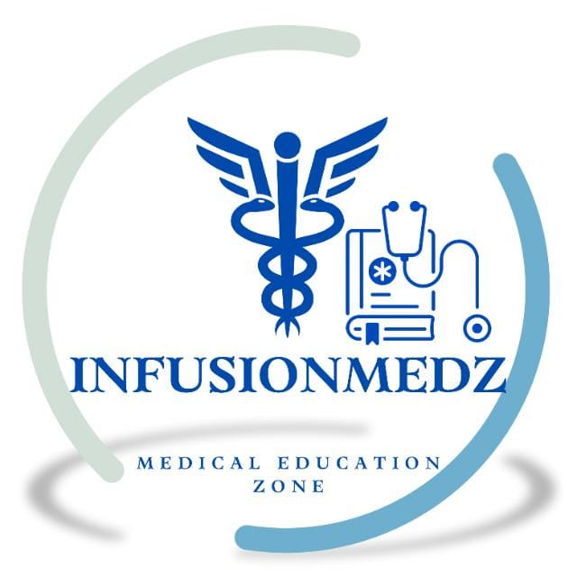
MANAGEMENT OF CORONARY CALCIUM
Dr. Akif Baig
SCAI Expert Consensus Statement on the Management of Calcified Coronary Lesions. Journal of the Society for Cardiovascular Angiography & Interventions. 2023;3:101259

Slide 2
Rising comorbidities have increased coronary artery calcification (CAC) and its association with obstructive coronary artery disease (CAD)
PCI in calcified CAD has lower procedural success and higher early and late complication rates.
Coronary calcification can:
Impede stent delivery and deployment
Cause stent underexpansion and malapposition
Lead to direct stent damage

Slide 3
Intravascular imaging (e.g., IVUS/OCT) is increasingly used to:
Define the extent, type, and location of calcium
Guide calcium modification strategies
Improve optimal stent deployment and reduce adverse events

Slide 4
Coronary Artery Calcification (CAC)
CAC develops alongside atherosclerosis and shares common pathophysiology.
Prevalence increases with age, starting in middle age; most individuals ≥80 years have CAC.
Major risk factors for CAC include:
Chronic kidney disease
Diabetes mellitus
Hypertension
Tobacco use
High body mass index
Inflammation
Family history of heart disease

Slide 5
CAC shows heterogeneous patterns, ranging from:
Flow-limiting obstructive stenoses
Partially obstructive or non-obstructive lesions confined to the vessel wall
Lesions with or without positive remodeling

Slide 6
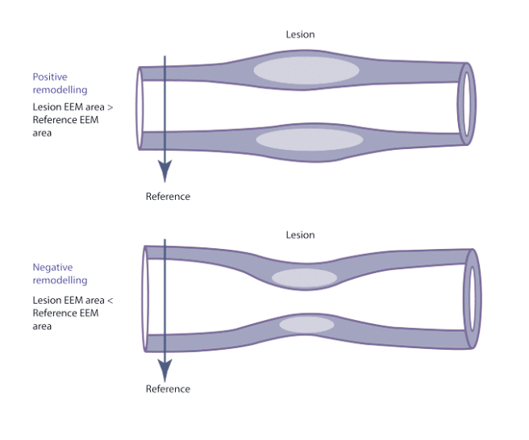

Slide 7
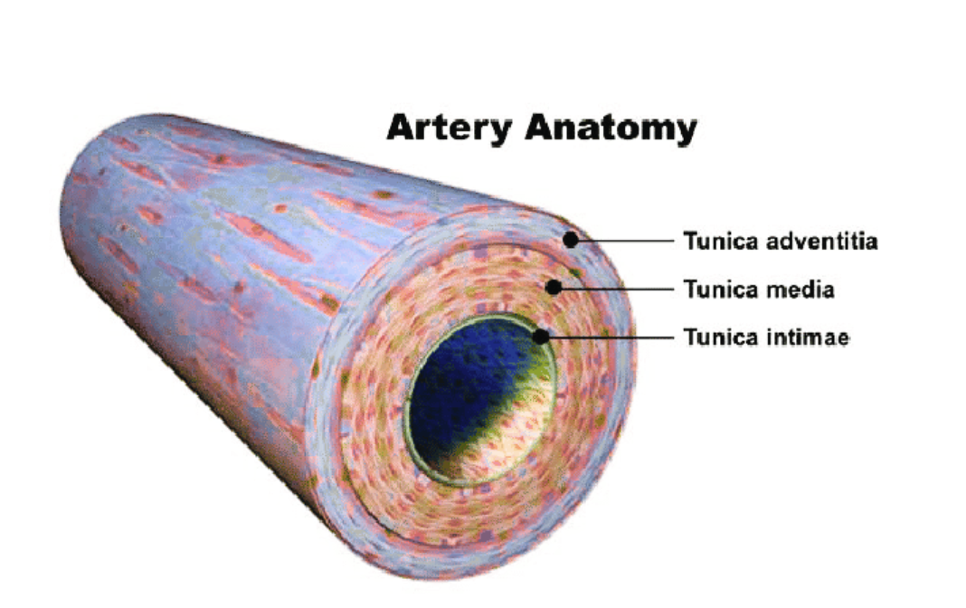
Calcification may:
Replace the intimal layer
Develop subintimally
Based on stage and biology, CAC can appear as:
Microcalcification (often linked to unstable plaques)
Fibrocalcification
Thick or thin calcific sheets, concentric or eccentric
Hydroxyapatite crystals may aggregate to form calcified nodules, with or without a fibrous cap

Slide 8
Identification of calcified coronary lesions
Preprocedural identification
CAC can be detected on noninvasive CT scans done for cardiac or noncardiac indications.
CT provides useful information on location and extent of CAC, even without Agatston scoring or dedicated coronary CTA.

Slide 9
Intraprocedural identification
CAC may be detected using fluoroscopy or intravascular imaging.
Fluoroscopy accuracy depends on calcium arc, length, and thickness.
Sensitivity ~50% and specificity ~95% vs intravascular imaging.
Limitations of fluoroscopy:
Poor resolution for CAC subtype
May overestimate calcium in some cases

Slide 10
Role of intravascular imaging (IVUS/OCT)
Improves detection and characterization of CAC.
Defines:
Calcium phenotype (nodules vs sheet calcium)
Superficial vs deep wall calcium
Arc, length, and thickness
Associated with better clinical outcomes in complex PCI.

Slide 11
Guideline recommendations
ACC/AHA/SCAI 2021 Revascularization Guidelines:
IVUS: Class IIa, LOE B-R for procedural guidance, especially in left main/complex PCI.
OCT: Reasonable alternative to IVUS, except in ostial left main disease.

Slide 12
Imaging characteristics
IVUS: Bright echoes with acoustic shadowing.
OCT: Low backscatter, low attenuation, sharp borders.
Both IVUS and OCT measure arc and length.
Only OCT can accurately measure calcium thickness.
OCT has higher resolution but:
Limited penetration depth
Requires blood clearance

Slide 13
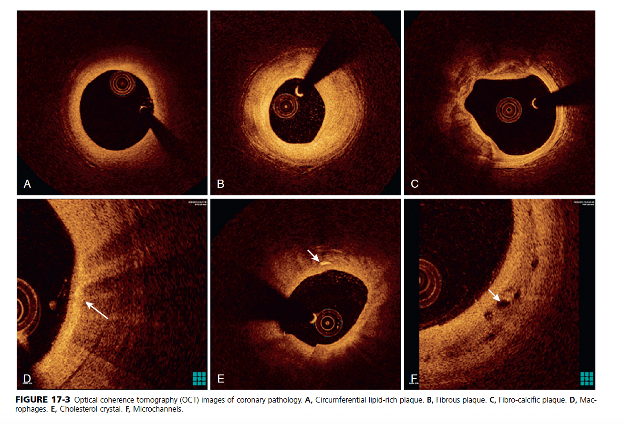

Slide 14
IVUS-based morphologic predictors (calcified coronary lesions)
IVUS parameter | Threshold / Feature | Clinical significance
Calcium arc | 360° circumferential calcium | Greater stent expansion (>70%) with calcium modification
Calcium arc + length | >270° arc with calcium length ≥5.0 mm | Improved stent expansion after calcium modification
Vessel diameter | <3.5 mm | Higher benefit from calcium modification to achieve optimal expansion
Calcified nodules (CN) | Presence of CN | Associated with improved stent expansion when modified

Slide 15
OCT-based morphologic predictors (calcified coronary lesions)
OCT parameter | Threshold / Feature | Clinical significance
Maximum calcium angle | Larger angle | Independent predictor of stent underexpansion
Calcium length | Longer length | Independent predictor of stent underexpansion
Calcium thickness | Increased thickness | Independent predictor of stent underexpansion
Calcium thickness (post-modification) | <0.5 mm | Higher likelihood of calcium fracture after modification

Slide 16
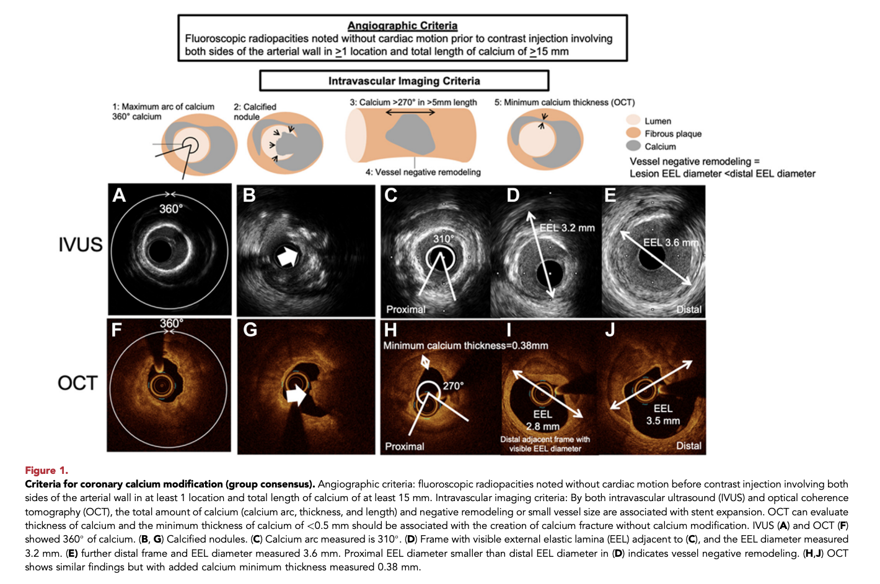
Riley RF, Patel MP, Abbott JD, Bangalore S, Brilakis ES, Croce KJ, et al. SCAI Expert Consensus Statement on the Management of Calcified Coronary Lesions. Journal of the Society for Cardiovascular Angiography & Interventions. 2023;3:101259. doi:10.1016/j.jscai.2023.101259

Slide 17
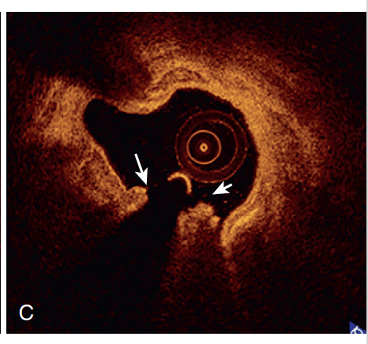
Calcified Nodules (CNs)

Slide 18
Definition:
CN is a convex calcium mass protruding into the lumen, overlying a severely calcified plate.
May be eruptive, with fibrous cap disruption and luminal thrombus.

Slide 19
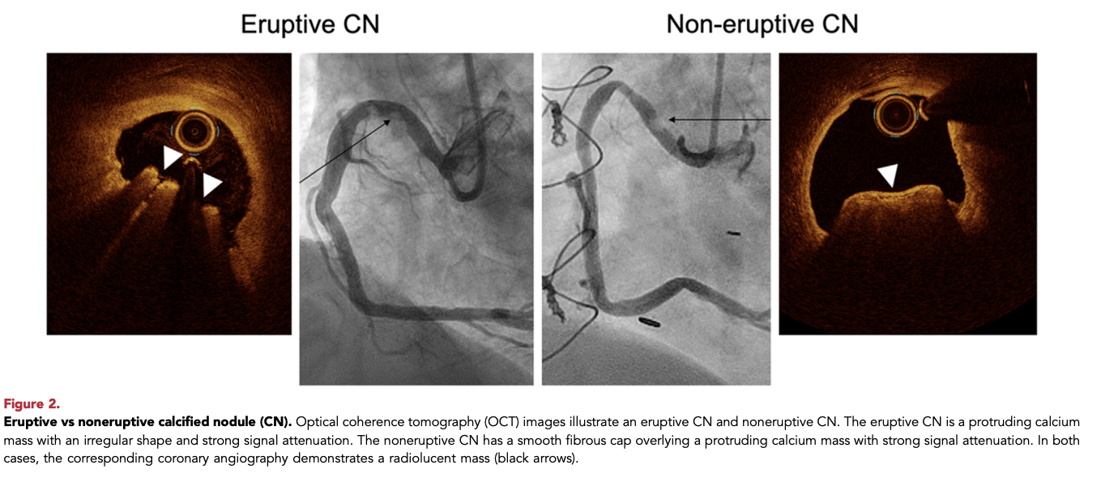

Slide 20
Angiographic appearance:
Large CNs can appear as radiolucent masses, mimicking thrombus.
Prevalence:
Rare in general obstructive CAD (<5%).
Much more common (~32%) in severely calcified lesions (maximum calcium angle >270°).

Slide 21
Common locations & associations:
Occur at hinge-motion segments of coronary arteries.
More frequent in the right coronary artery (RCA).
Higher prevalence in patients on chronic hemodialysis.

Slide 22
Clinical impact:
Presence of CN during PCI is linked to higher long-term MACE compared with calcified lesions without CNs.
Early restenosis often due to reprotrusion of the CN into the stent.

Slide 23
Imaging characteristics:
OCT: Differentiates eruptive CNs (irregular surface) from noneruptive CNs (smooth fibrous cap).
IVUS: Can identify CN shape and surface irregularity but has lower resolution and depth than OCT.

Slide 24
Prognosis:
Eruptive CNs show worse long-term outcomes despite better acute stent expansion, likely due to higher risk of reprotrusion.

Slide 25
Long calcified lesions
Often associated with diffuse CAD and long-standing/uncontrolled risk factors.
Linked to higher long-term adverse cardiovascular events.
Longer calcium segments increase the risk of stent underexpansion during PCI.
Stenosis and severe calcification may not co-localize in long lesions.
Intravascular imaging is essential to:
Precisely localize severely calcified segments
Target calcium modification to areas at highest risk of underexpansion

Slide 26
Chronic total occlusion (CTO) interventions
PCI of calcified CTOs has:
Lower procedural success
Higher complication rates than noncalcified CTOs
Preprocedural chest CT and intravascular imaging help:
Define calcium distribution and morphology
Guide strategy selection

Slide 27
Proximal cap calcification reduces antegrade wiring success; may be identified via side-branch imaging.
During retrograde CTO techniques, intravascular imaging helps:
Identify less calcified reentry zones
Improve retrograde guidewire reentry success

Slide 28
In-stent restenosis (ISR)
Defined as ≥50% stenosis within the stent on follow-up angiography.
Calcium-related ISR mechanisms:
Initial stent underexpansion due to underlying calcification
Calcified neoatherosclerosis within the stent

Slide 29
Prevalence of calcified neoatherosclerosis:
~10% at 5–7 years
~20% beyond 7 years after DES implantation
Imaging predictors of repeat underexpansion:
Large calcium arc (>180°)
Thick calcium (>0.5 mm) within or adjacent to the stent

Slide 30
Post–coronary artery bypass surgery (CABG)
Patients with severe coronary calcification have similarly high long-term mortality with PCI or CABG.
Most studies show accelerated atherosclerosis progression in grafted vessels.
Intravascular imaging reveals that native vessels proximal to graft anastomoses show:
More severe calcification
Higher prevalence of calcified nodules
Greater negative remodeling compared with patients without prior CABG

Slide 31
TREATMENT MODALITIES FOR
CALCIFIED CAD

Slide 32
Semicompliant (SC) and Noncompliant (NC) balloons
Used for:
Mildly calcified lesions
Initial preparation of more severe calcification
Mechanism:
Do not remove calcium
Create medial dissections and disrupt thin calcium to increase plaque elasticity
Limitations in calcified lesions:
Eccentric balloon expansion → risk of perforation or flow-limiting dissection
“Watermelon-seeding” toward non-diseased segments
Nonuniform expansion → balloon rupture, uncontrolled dissection, or perforation

Slide 33
Cutting balloons (CB)
Less compliant balloons with microsurgical blades
Mechanism:
Create controlled incisions
Fracture calcium and improve symmetric stent expansion
Reduce balloon slippage
COPS trial:
CB vs NC balloon in severe CAC
Higher minimum stent area (MSA) at calcium site with CB (8.2 vs 7.3 mm²; P = 0.035)
No difference in final MSA
Wolverine CB:
Lower-profile design
Improved deliverability vs older CBs

Slide 34
Scoring balloons
Designed for better deliverability and less vessel trauma than CBs
Comparative data:
Wolverine CB more deliverable than Lacrosse NSE ALPHA
Similar cross-sectional area gain
Available scoring balloons:
AngioSculpt: SC balloon with 3–4 helical nitinol scoring elements
Chocolate XD: SC balloon with nitinol cage creating pillows and grooves to control dissections
Scoreflex NC: NC balloon with integrated nitinol wire; guidewire acts as second scoring element

Slide 35
High-pressure balloons (OPN balloon)
Double-layer balloon capable of very high pressures
Study findings (326 undilatable lesions):
53% yielded at 30–40 atm
47% required >40 atm
Angiographic success: 97.5%
Procedural success: 96.6%
Vessel perforation occurred in 3 patients
Technical recommendations:
Predilation: undersize by 0.5 mm
Postdilation: 1:1 sizing
Limitations:
Higher risk of perforation, especially pre-stenting
Balloon increases in size at high pressure
Bulky profile and stiffness → difficult re-crossing

Slide 36
Balloon-based treatment modalities for calcified CAD
Balloon type | Examples | Mechanism of action | Indications | Advantages | Limitations / Risks
Semicompliant (SC) balloons | Standard SC balloons | Expand with vessel compliance; create minor dissections | Mild calcification; initial lesion preparation | Easy deliverability; widely available | Eccentric expansion, watermelon seeding, limited efficacy in severe CAC
Noncompliant (NC) balloons | Standard NC balloons | High-pressure dilation; disrupt thin calcium | Mild–moderate CAC; post-modification optimization | Controlled sizing; high-pressure capability (20–24 atm) | Risk of perforation, uncontrolled dissection, balloon rupture in severe CAC
Cutting balloons (CB) | Wolverine CB (Boston Scientific) | Microsurgical blades create controlled incisions and calcium fractures | Severe CAC for plaque modification | Predictable dissection planes; less slippage; improved MSA at calcium site | Higher perforation risk; not for full lesion dilation alone
Scoring balloons | AngioSculpt, Chocolate XD, Scoreflex NC | External scoring elements focus force on plaque | Moderate CAC; ostial lesions | Better deliverability; reduced slippage; controlled dissections | Limited efficacy in deep or circumferential calcium
High-pressure balloons | OPN balloon (SIS Medical) | Double-layer balloon allows ultra–high-pressure dilation | Undilatable lesions resistant to NC balloons | Very high angiographic and procedural success | Increased perforation risk; balloon growth at high pressure; difficult re-crossing

Slide 37
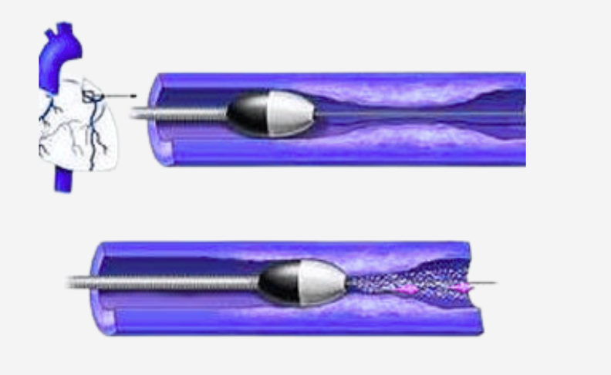
ROTATIONAL
ATHERECTOMY

Slide 38
Burr sizing
Recommended burr-to-artery ratio: 0.4–0.6
1.5-mm burr for arteries ≤3.0 mm
1.75-mm burr for arteries >3.0 mm
Avoid 1.25-mm burr as first burr due to higher entrapment risk

Slide 39
Guide catheter selection
1.25–1.5 mm burr → 6F guide
1.75 mm burr → large 6F (0.071”) or 7F guide
2.0 mm burr → large 7F (0.081”) or 8F guide
2.15 mm burr → 8F guide

Slide 40
Guide wire considerations
RotaWire types: floppy and extra support
Floppy wire: less vessel straightening, reduced wire bias, easier ablation in tortuous segments
Extra support wire: better deliverability and eccentric plaque modification, but higher perforation risk
Primary wiring with RotaWire is often feasible

Slide 41
Wire and burr safety
Keep distal RotaWire tip visible
Maintain ≥5 mm distance between burr and radiopaque wire segment
Reposition wire between runs to prevent wire fracture

Slide 42
Lubrication and flushing
Use continuous RotaGlide infusion to reduce friction and heat
Avoid RotaGlide in patients with egg or olive oil allergy
Alternative: saline + heparin ± vasodilators (nitroglycerin/verapamil)

Slide 43
Ablation technique
Use short, pecking motions
Each run <30 seconds
Avoid burr deceleration >5000 rpm
Perform a final polishing run with minimal resistance

Slide 44
Troubleshooting uncrossable lesions
Increase rotational speed
Downsize burr
Improve guide support or use guide catheter extension
Extension requirements:
1.25 mm burr → 7F extension
1.5–1.75 mm burr → 8F extension
2.0 mm burr → not compatible with extensions

Slide 45
Temporary pacing
Usually not required with small burrs
Consider in patients with baseline conduction disease or low LV reserve, especially during RA of dominant RCA or circumflex

Slide 46
The 2021 ACC/AHA/SCAI Coronary Artery Revascularization guidelines gave a 2a, level of evidence B-R, recommendation for the use of RA in patients with heavily calcified lesions, noting that RA “can be useful to improve procedural success.

Slide 47
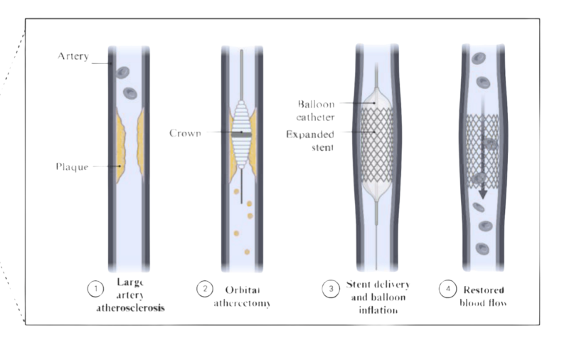
ORBITAL ATHERECTOMY
Guide catheter requirements
Minimum 6F guide catheter
7F system recommended if a guide extension is planned
Guide wire selection
Primary wiring usually feasible with ViperWire Advance
FlexTip option: 0.012″ nitinol core with 0.014″ tip
Wire safety
Keep distal ViperWire tip in view
Maintain ≥5 mm distance between wire tip and OA drive shaft to avoid wire fracture

Slide 48
Vasodilator use
Administer nitroglycerin before the first run and intermittently
Helps minimize slow flow, as tolerated hemodynamically
Ablation technique
Use smooth forward or backward motion at ~1.0 mm/s
Slower motion and more runs correlate with greater lumen gain
Never use force
Ensure 1:1 motion between crown and advancer knob; if movement stops, do not push
Rotational speed
Start at 80,000 rpm in all vessels
Increase to 120,000 rpm in vessels ≥3.0 mm for larger lumen gain

Slide 49
Run duration and total time
Individual runs ≤30 seconds
Total treatment time with same crown ≤5 minutes
Rest periods
Rest time between runs should be at least equal to treatment time
Rest in a nonocclusive position within the vessel
Conduction disturbances
Transient conduction issues may occur in dominant RCA or circumflex
Consider prophylactic aminophylline or temporary pacing when appropriate
Ostial lesion caution
OA at ostial lesions carries risk of aortic dissection
May be performed cautiously by experienced operators using distal positioning and retrograde activation, avoiding unrestricted crown orbit at the ostium

Slide 50
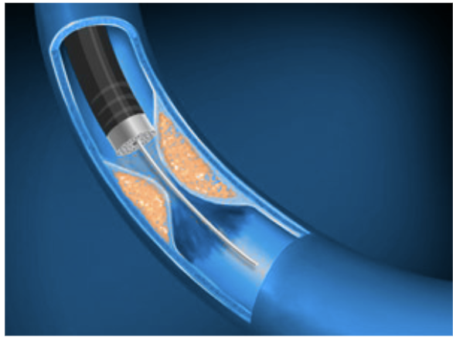
Excimer Laser Coronary Atherectomy (ELCA)
Energy settings
Although low settings are recommended by manufacturers, maximum settings are commonly used for calcified lesions
Typical setting for 0.9-mm catheter: 80 mJ/mm² at 80 Hz
Higher fluence increases vapor bubble size and calcium modification
Catheter sizing
Choose catheter diameter ≈ two-thirds of the vessel diameter
Advancement technique
Advance catheter slowly (<1.0 mm/s) to maximize time-dependent ablation

Slide 51
Direction of laser use
Forward-only motion for tissue ablation (uses front-facing energy)
Bidirectional motion to improve lesion compliance via acoustic mechanical effects
Perforation prevention
Continuously monitor nose cone orientation
If catheter stalls and deflects, stop—laser may be directed toward the adventitia
Contrast-assisted laser (off-label)
Contrast injection during laser activation increases cavitation and calcium fracture
Useful for in-stent underexpansion due to calcium
Carries higher risk of no-reflow and perforation

Slide 52
Device-related complications
Rare risk of distal radiopaque marker band separation with contrast use
Guide wire caution
Avoid ELCA on polymer-jacketed guide wires due to risk of polymer damage

Slide 53
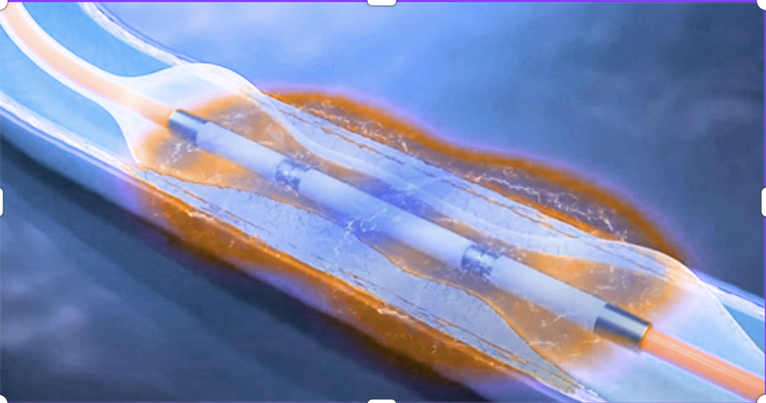
Consensus tips for Intravascular Lithotripsy (IVL)
Best lesion type
Most effective for circumferential calcium in balloon-crossable lesions
Effective in eccentric and nodular calcium, but may require more pulses
Combination strategies
Can be used synergistically with atherectomy
Particularly useful in long lesions with heterogeneous vessel size and calcium pattern

Slide 54
Hemodynamic considerations
Use longer rest periods between pulse deliveries to reduce hemodynamic compromise
Especially important in lesions supplying large myocardial territories (e.g., left main)
Guide wire compatibility
Safe to use with multiple guide wires in place
Advantageous in bifurcation lesions
Role of intravascular imaging
Imaging helps identify optimal pulse locations, especially in long lesions
Useful post-atherectomy, as atherectomy often modifies calcium in smaller vessel segments but may be less effective in larger segments

Slide 55
Consensus tips for Calcified Nodules (CNs)
Role of intracoronary imaging
Essential to define CN location, overall calcium distribution, and guide-wire bias
Helps determine reference vessel size and select the optimal calcium-modification device
Orbital atherectomy (OA) strategy
Use slow crown motion (~1 mm/s)
Perform a high number of passes (>5)
Prefer higher speed (120,000 rpm) for effective CN modification

Slide 56
Rotational atherectomy (RA) strategy
Improve burr contact by:
Increasing burr-to-artery ratio to 0.6–0.7 in large lumens
Using RotaWire Extra Support to correct unfavorable wire bias
Intravascular lithotripsy (IVL) strategy
Size IVL balloon 1:1 with reference vessel diameter
Expect need for more pulses compared with non-CN lesions
Pre-stenting optimization
Perform 1:1 noncompliant (NC) balloon dilation
Prefer repeat intravascular imaging to confirm calcium fracture before stent deployment

Slide 57
Consensus tips for Chronic Total Occlusions (CTOs)
Intraplaque crossing + device-uncrossable lesions
Bury a microcatheter in the proximal cap and exchange to a RotaWire
Rotational atherectomy (RA) preferred over OA due to risks of orbital motion in dissection planes
If dissections are present, use a 1.5-mm RA burr (forward ablative tracking; lower perforation risk than larger burrs)
When RotaWire exchange is not feasible
Consider excimer laser coronary atherectomy (ELCA) with a 0.9-mm catheter at 80/80 settings
Off-label contrast-assisted ELCA may be required for in-stent undilatable calcified lesions

Slide 58
Intraplaque crossing + balloon-crossable lesions
Perform initial balloon predilatation
Choose the calcium-modification device based on intravascular imaging findings
Extraplaque crossing with residual calcium
If balloon angioplasty is suboptimal, consider intravascular lithotripsy (IVL)
RA may be used, but published experience is limited

Slide 59
Consensus tips for In-Stent Restenosis (ISR)
Initial assessment
Perform intravascular imaging (IVUS/OCT) whenever feasible to identify:
Mechanism of stent failure
Distribution of calcium (calcified neoatherosclerosis vs calcium behind stent struts)
Calcified neoatherosclerosis
Treat similar to de novo calcified lesions:
1:1 sized NC balloon
Cutting or scoring balloon, followed by 1:1 NC balloon
High-pressure balloon (undersized by 0.5 mm)
Atherectomy or IVL (1:1 sizing) as needed

Slide 60
Calcium behind stent struts with stent underexpansion
Consider:
Off-label IVL (1:1 sizing)
High-pressure balloon (undersized by 0.5 mm)
ELCA with off-label contrast
Atherectomy (RA with burr-to-artery ratio >0.5)
Balloon-uncrossable ISR lesions
Use ELCA (0.9-mm catheter) or RA (0.5 burr-to-artery ratio)

Slide 61
Consensus tips for Aorto-ostial lesions
Balloon-crossable lesions
Use cutting or scoring balloons
Consider high-pressure balloons
Intravascular lithotripsy (IVL) is an effective option for lesion preparation
Balloon-uncrossable lesions
Proceed with atherectomy

Slide 62
Rotational atherectomy (RA)
Use burr-to-artery ratio ~0.5
Ensure coaxial guide catheter support
Consider upsizing guide catheter by +1F to reduce risk of guide catheter ablation
Orbital atherectomy (OA)
Associated with risk of aortic dissection in ostial lesions
May be used cautiously by experienced operators
Advance device distal to lesion with glide assist
Activate retrogradely, avoiding unrestricted crown orbit at the ostium

Slide 63


